Slide 1
Urban Dictionary
Urban Dictionary defines data as:
"Data is information. It is also the name of an android on Star Trek the Next Generation"
-e4cfc7a3
VANESSA OAKES

Slide 2
Gathering Data:
This dataset contains 2.6 million words from Urban Dictionary.com
Source: https://www.urbandictionary.com
Dataset: https://www.kaggle.com/therohk/urban-dictionary-words-dataset
Format: CSV
Data last updated May 2016

Slide 3
Data Input
word_id - unique id for urban dictionary api
word
up_votes/ thumbs up count as of may 2016
down_votes/ thumbs down count as of may 2016
author
definition
Urban Dictionary defines input fairy as:
"The act of putting information into a software database. According to the Graphic Arts Department. (aka Peter) ” -8a38ed0f

Slide 4
Cleaning the data
Checked if there was any blank definitions and deleted. There were 188 blank definitions that I removed.
df.loc[df['definition']==" "]
null_definitions=df[df["definition"].isnull()]
Removed duplicates for word_id,word, author, and definitions
Urban Dictionary defines cleaning as:
"To go into a store or shop and discreetly steal items which are for sale without getting caught. These items can range anywhere in size from a basketball to a dixie cup. Useless items you don't really need are sometimes taken because many people do it for the rush as opposed to needing the stolen object.” - 85f068dd

Slide 5
Limitations
Didn’t end up having age
To scrape or to not scrape
Decided to have enough information (2.6 million words) that it would take too long to scrape over ½ a gig of data
Doesn’t have location
Basically missing a lot of information that could make this more interesting
Urban Dictionary defines limitations as:
"a berrier our minds make to try to make what you can do seem great. what the cops put on speed” -coman November 24, 2004

Slide 6
Issues
A lot of use of emoticon since it’s user input based so we used error_bad_lines=False when bringing the file in.
Could only really clear out ”NAN” but still had parsing errors.
Random use of curly quotes as a delimiter.
Had to clean duplicate definitions.
Urban Dictionary defines issues as:
"substitute problems for people who have no real life worries. problems that would not exist if the 'issuee' would only stop thinking about them, unlike authentic problems such as hunger, disease, poverty etc.” -d22cf443
"you wear them on your ifeet” - d4800b91

Slide 7
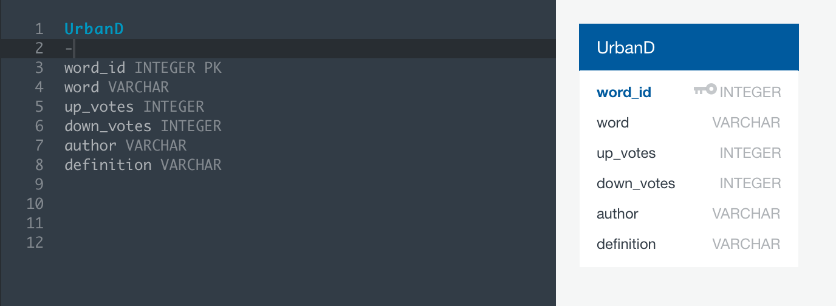
Database:
Final database matched the original CSV just cleaner.
Urban Dictionary defines database as:
"A place where the wall of pure fiction cracks in one's head and where the addiction of one's world still spreads. A place where people struggles and doesn't matter is there is hope as the madness of the system grows.”
- d3e483ab

Slide 8
Outcomes
Removed duplicate words and meanings
Authored most contributed
Urban Dictionary defines Outcomes as:
"The opposite of income. It is the money you spend, that you may (or may not) make back up.” - b36730bf

Slide 9
Conclusion
Urban Dictionary is a messy place that lacks thought as to keep it organized.
It also hasn’t been really updated so has continued to stay dirty.
The dataset is surprisingly large with only deleted 133 rows of “NAN”
Urban Dictionary defines conclusion as:
"The place where you got tired of thinking.”
-75ef88d9

Slide 10
Urban Dictionary defines Berkeley as:
"a town in california, also were green day lives!” -167b8993

